Slide 1
PROJECT TITLE
CAPSTONE PROJECT
Presented By:
Jeevan R P
Achariya College of Engineering Technology
Department of Computer Science Engineering

Slide 2
OUTLINE
Problem Statement
System Development Approach
Algorithm & Deployment (Step by Step Procedure)
Result
Conclusion
Future Scope
References

Slide 3
Problem Statement
This project aims to build an AI model to predict employee salaries. It uses data like job role, experience, education, and location. The goal is to help companies offer fair and accurate pay. It supports better HR decisions and reduces salary gaps. The model learns from past employee salary records.

Slide 4
System Approach
System Requirements
Hardware:
At least 4GB RAM (8GB is better)
A good processor (CPU or GPU)
Some free storage space (around 10GB)
Software:
Any OS (Windows, Linux, or macOS)
Python 3.7 or higher
Jupyter Notebook or any Python editor
Libraries Needed
Pandas – to handle data
Numpy – for calculations
Matplotlib, seaborn – for graphs
Scikit-learn – to build and test the model
Joblib – to save the model

Slide 5
Algorithm & Deployment
Get the Data
Use a dataset with details like job, experience,
education, and salary.
Clean the Data
Remove missing or wrong data.
Change text to numbers where needed.
Split the Data
Divide into two parts: one for training, one for testing.
Train the Model
Use a machine learning algorithm to learn from the data.
Test the Model
Check how well it predicts salaries using the test data.
Improve the Model
Try other methods or settings to get better results.
Save and Use the Model
Save the model and create a simple tool to predict new salaries.

Slide 6
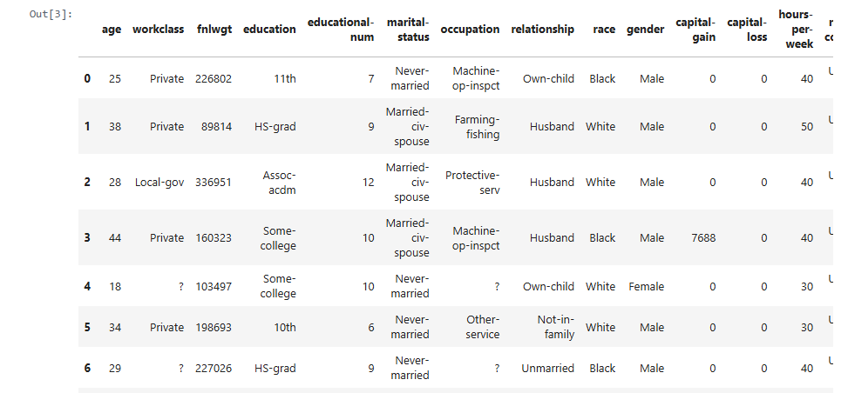
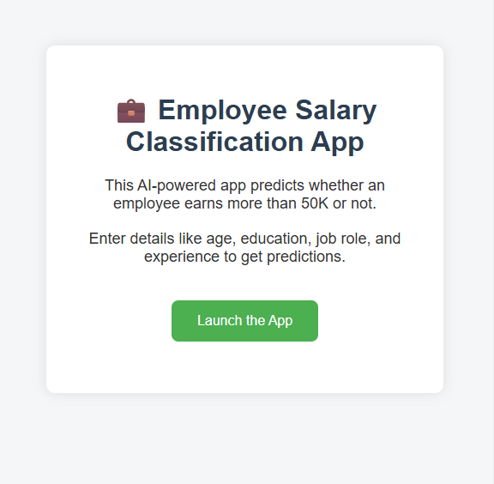
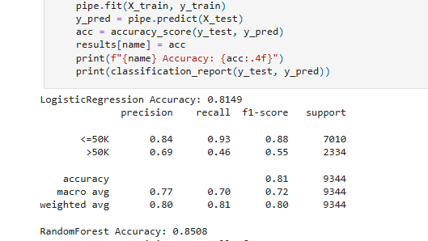
Result
GitHub Repo Link:
https://github.com/jeevan-rp/employee-salary-prediction

Slide 7
Conclusion
The project successfully predicts if an employee earns more than 50K using details like age, education, job role, experience, and hours worked. The model gives accurate results and works well for both single and batch predictions.
How Well It Works
The app is easy to use and gives quick results.
It helps HR teams make better salary decisions.

Slide 8
fUture scope
Use a more powerful model for better accuracy.
Add more features like location or company type.
Show graphs or explain why a prediction was made.
Host the app online for public access.

Slide 9
References
Dataset Source
UCI Machine Learning Repository – Adult Income Dataset https://archive.ics.uci.edu/ml/datasets/adult (as provided by mentor)
Project GitHub Repository
GitHub – Employee Salary Classification Project https://github.com/jeevan-rp/employee-salary-prediction

Slide 10
THANK YOU

